Slide 1

Presentation Materials Created by Mimetics Inc.
Free use by anyone for non-commercial purposes
Copyrights, Trademarks and other Registered Marks the Property of their Owners

Slide 2
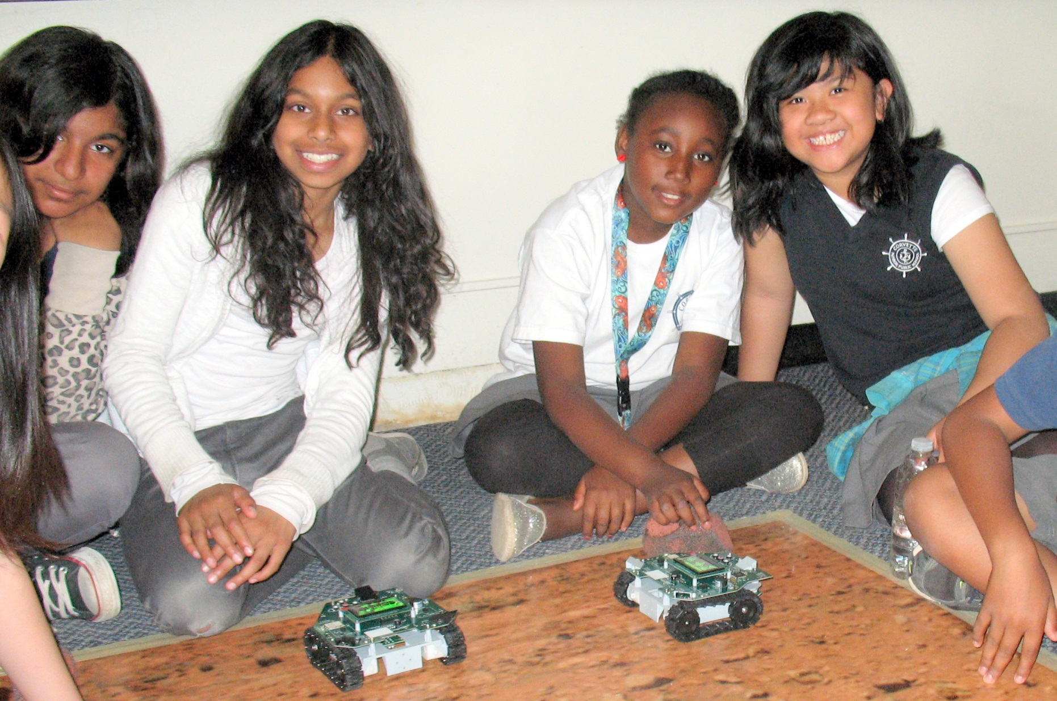
Introduction to Robotics and Programming with the Jade Robot
Notes:
We want to introduce the Jade Robot and it’s Tools in more detail along with our action plans for it.
It’s interesting, but it’s easy to criticize something when it’s done (especially when you have experience) – a *LOT* more difficult getting it right from the start. Also, preparing this presentation was a great way to review and think about what we should be doing.

Slide 3
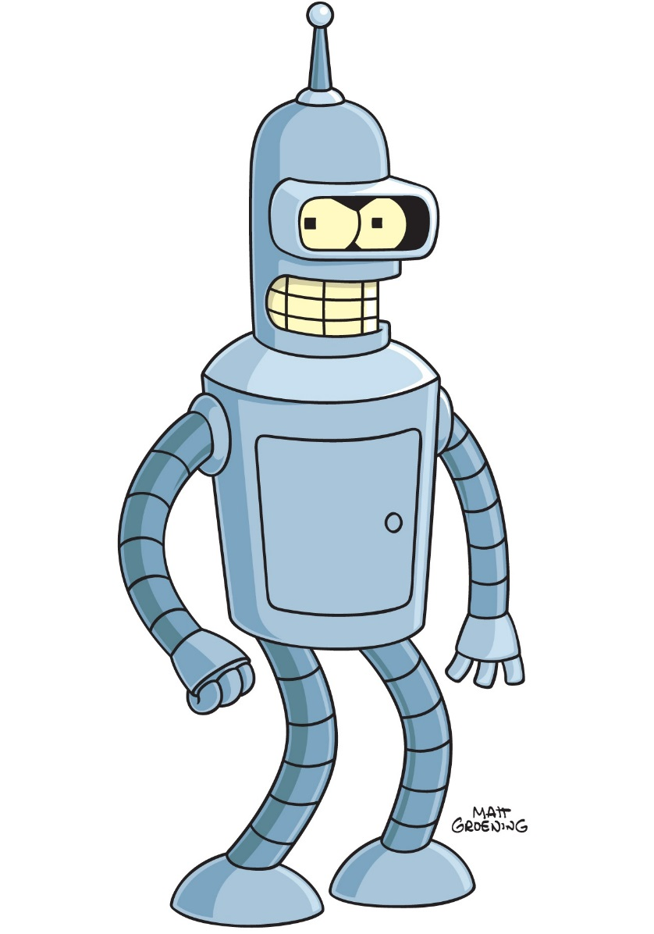
Objectives
What is a Robot?
What are the different types?
What is it Used for?
What do you want to do with one?
Learn about the Parts of a Robot
Movement & Output
Input (and Sensors)
Controller
Software
Notes:
Use the white boards to list the different robot types, uses & as what the kids want to use it for.
Note that Evaluating the Solution will be a competition.

Slide 4
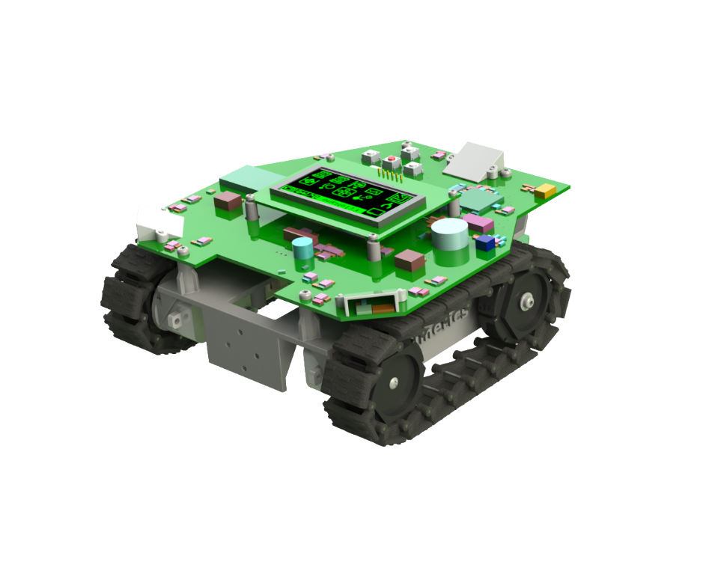
The Jade Robot
Camera
Interface
Navigation
Pad
Bluetooth
Interface
Two I²C
Expansion
Ports
OLED
Display
All Aspect
Object
Sensors
All Aspect
Light
Sensors
Speaker
DC Motors
Driving Tracks
Mounting
Plate
Spectrometer
and Line Sensors
On Bottom
Two Servo
Drivers

Slide 5
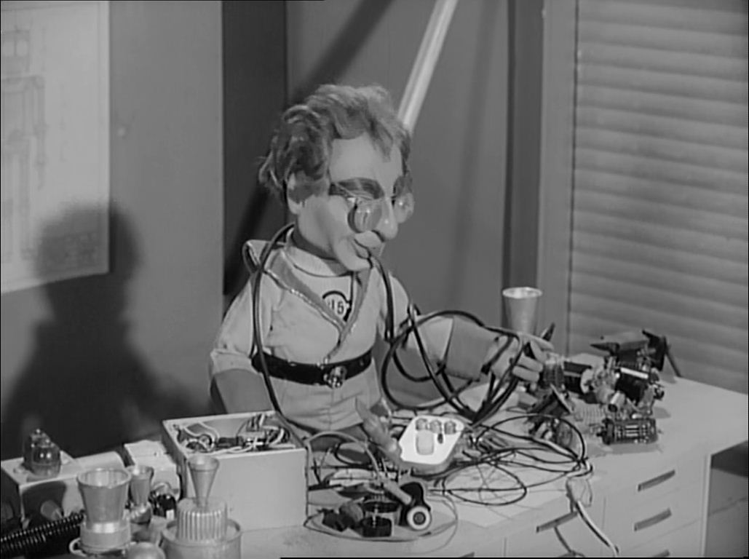
Rule One
Robots Run on the Floor
NO BROKEN ROBOTS!
Notes:
Can Demo Jade Scratch if people are interested. In doing this product I’ve had a few interesting discoveries – one was going with a simpler programming language actually has a *LOT* of value for an expert like myself.

Slide 6

Rule Two
We ALL Stay Together
Don’t Go Ahead Until Told
If You Have a Problem, Put Up Your Hand!
Notes:
Can Demo Jade Scratch if people are interested. In doing this product I’ve had a few interesting discoveries – one was going with a simpler programming language actually has a *LOT* of value for an expert like myself.

Slide 7
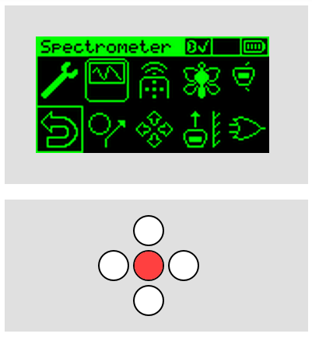
User Interface
“Tools” Menu
Basic Operations:
Press White “Down” Button to Wake Up
White Buttons to point to “Objects:
Programs
Controls
Red “Enter” Button Selects Object
End Program:
Go to “Return” Control (Bottom Left)
Press Red “Enter” Button
“Return”
Control
“Enter”
Button
Movement
(“Navigation”)
Buttons
“Wake Up”
Button
Notes:
Can Demo Jade Scratch if people are interested. In doing this product I’ve had a few interesting discoveries – one was going with a simpler programming language actually has a *LOT* of value for an expert like myself.

Slide 8
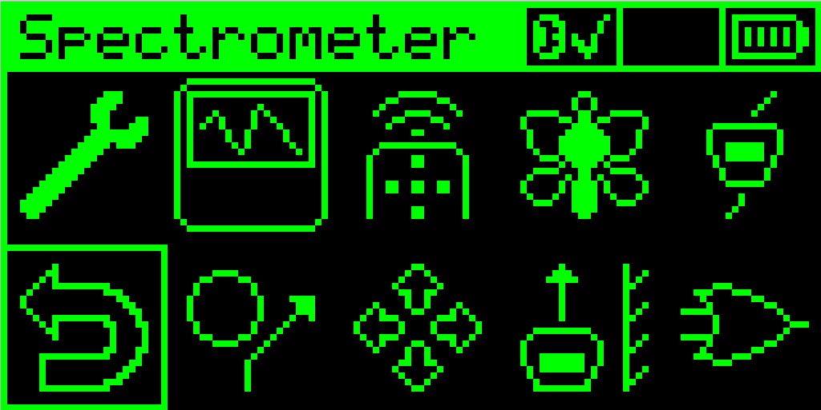
Experiment with Built in Programs
Remote Control
Light Seeking
Object Avoid
Wall Follow
Notes:
Show Off Different Activities they can start with

Slide 9
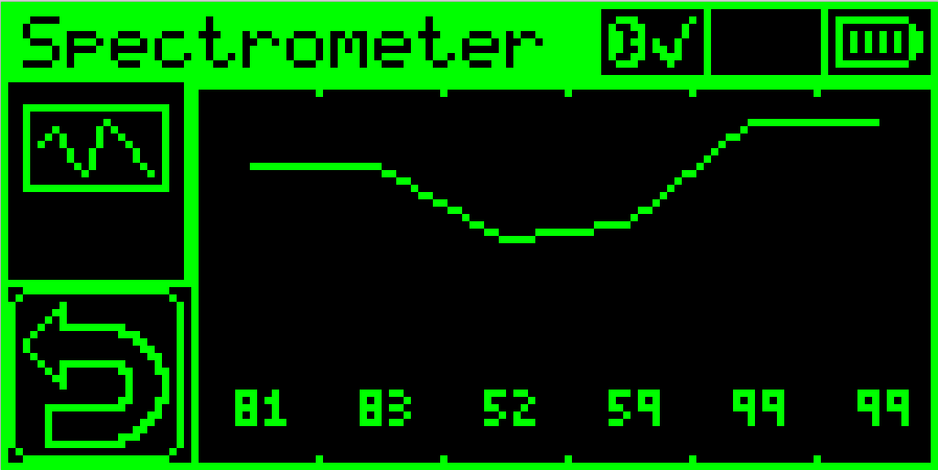
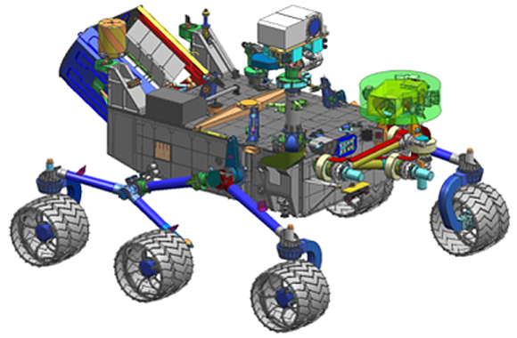
Reflectance Spectrometer
Place Robot on Object and Select “Spectrometer”
Compare Different Surfaces
Used on Space Craft
The Spectrometer Shines Different Wavelength (Colour) Light and Measures the Reflection
Different Materials Reflect Differently
Notes:
Show Off Different Activities they can start with

Slide 10
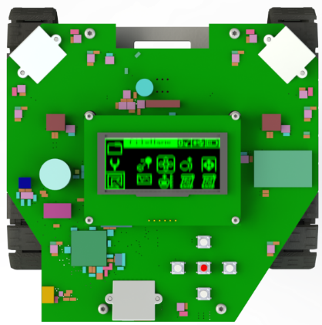
Robot Motion
Tracks Moving in
Same Direction &
Same Speed
Tracks Moving in
Different Direction
Or Different Speed
Notes:
Can Demo Jade Scratch if people are interested. In doing this product I’ve had a few interesting discoveries – one was going with a simpler programming language actually has a *LOT* of value for an expert like myself.

Slide 11
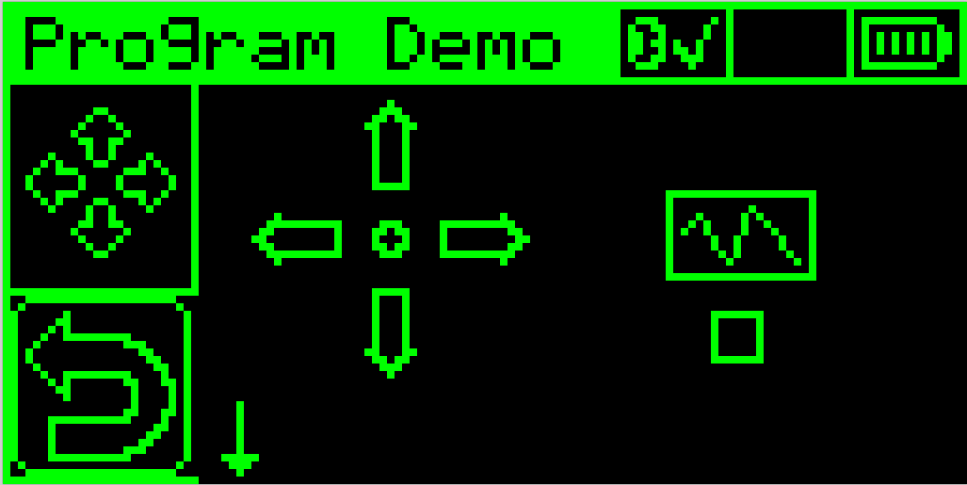
Simple Programming
Movement Selection
Execution Start
You can Create Your Own Program
Use the White (and Red) Buttons to Create a Program
Go to the Centre Control to Try the Program
Entered Program
Do Spectrometer
Reading at End
Notes:
Ask “What is a Program”?

